Slide 1
UML Diagrams

Slide 2
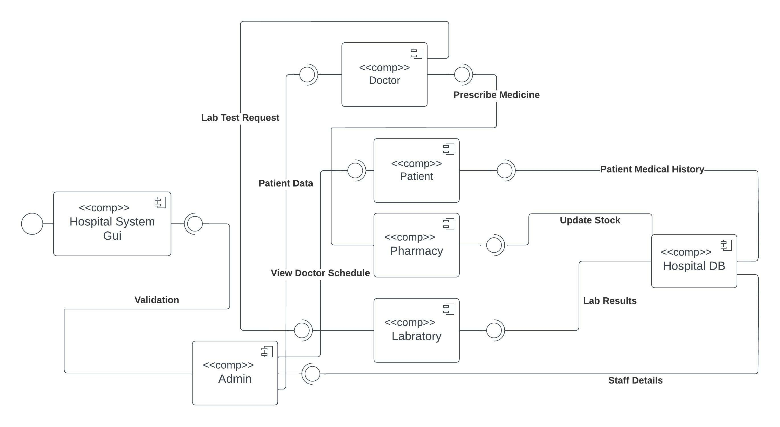
Component Diagram

Slide 3
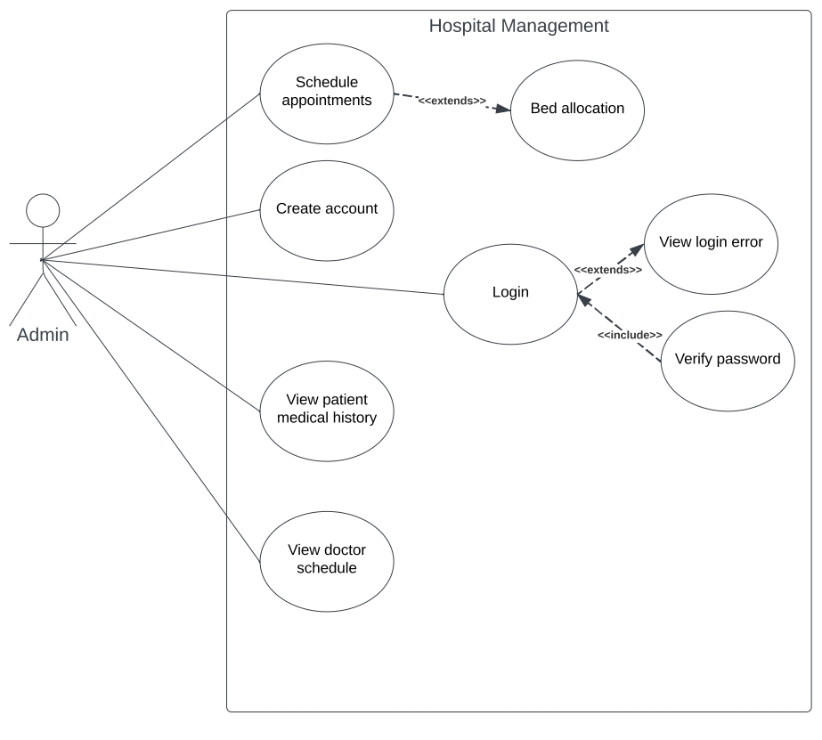
Admin Use Case

Slide 4
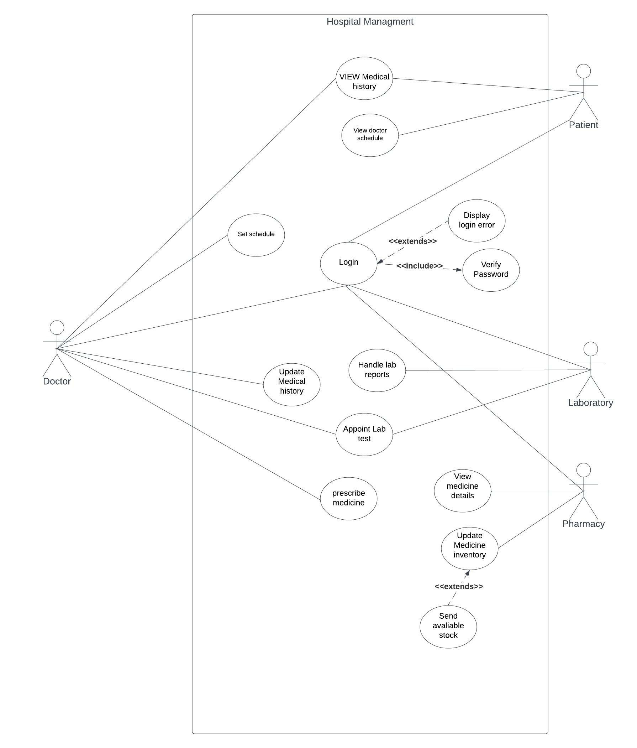
Doctor Use Case

Slide 5
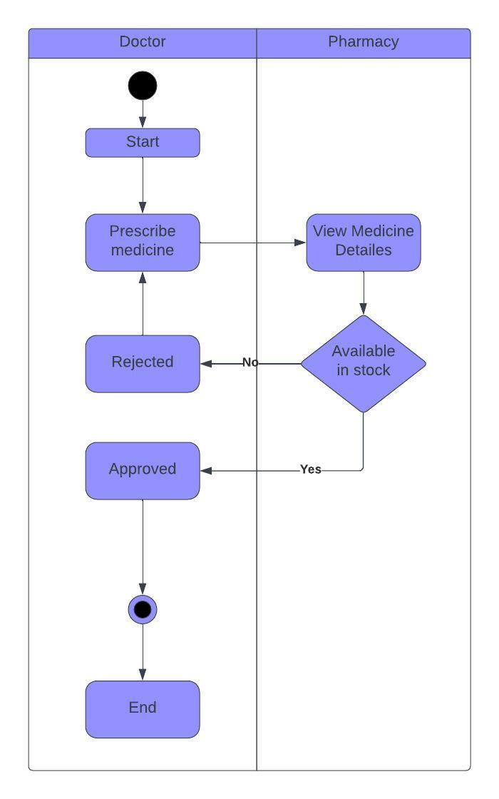
Doctor/Pharmacy Swim lane

Slide 6
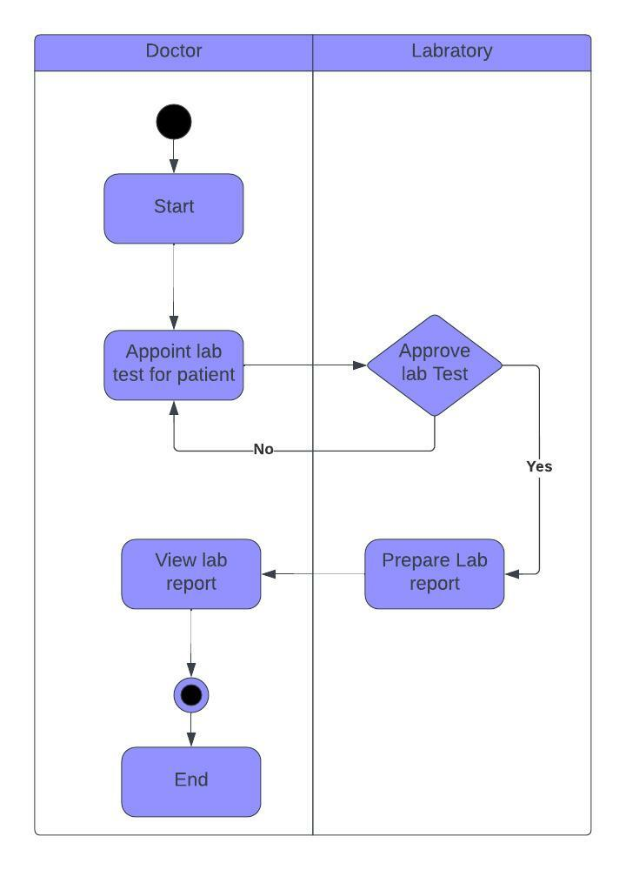
Doctor/Lab Swim lane

Slide 7
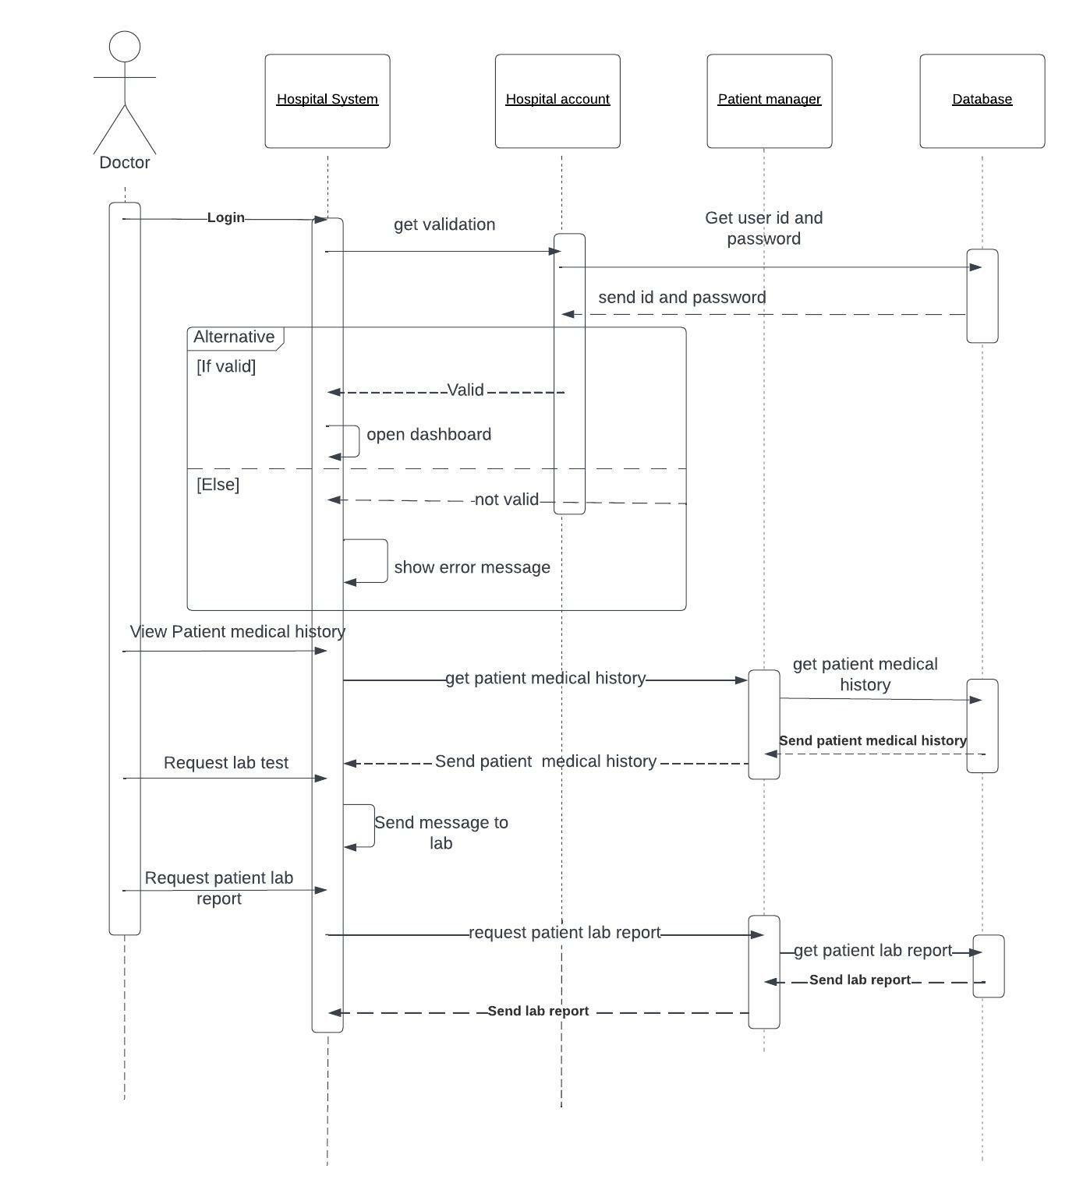
Doctor Sequence Diagram

Slide 8
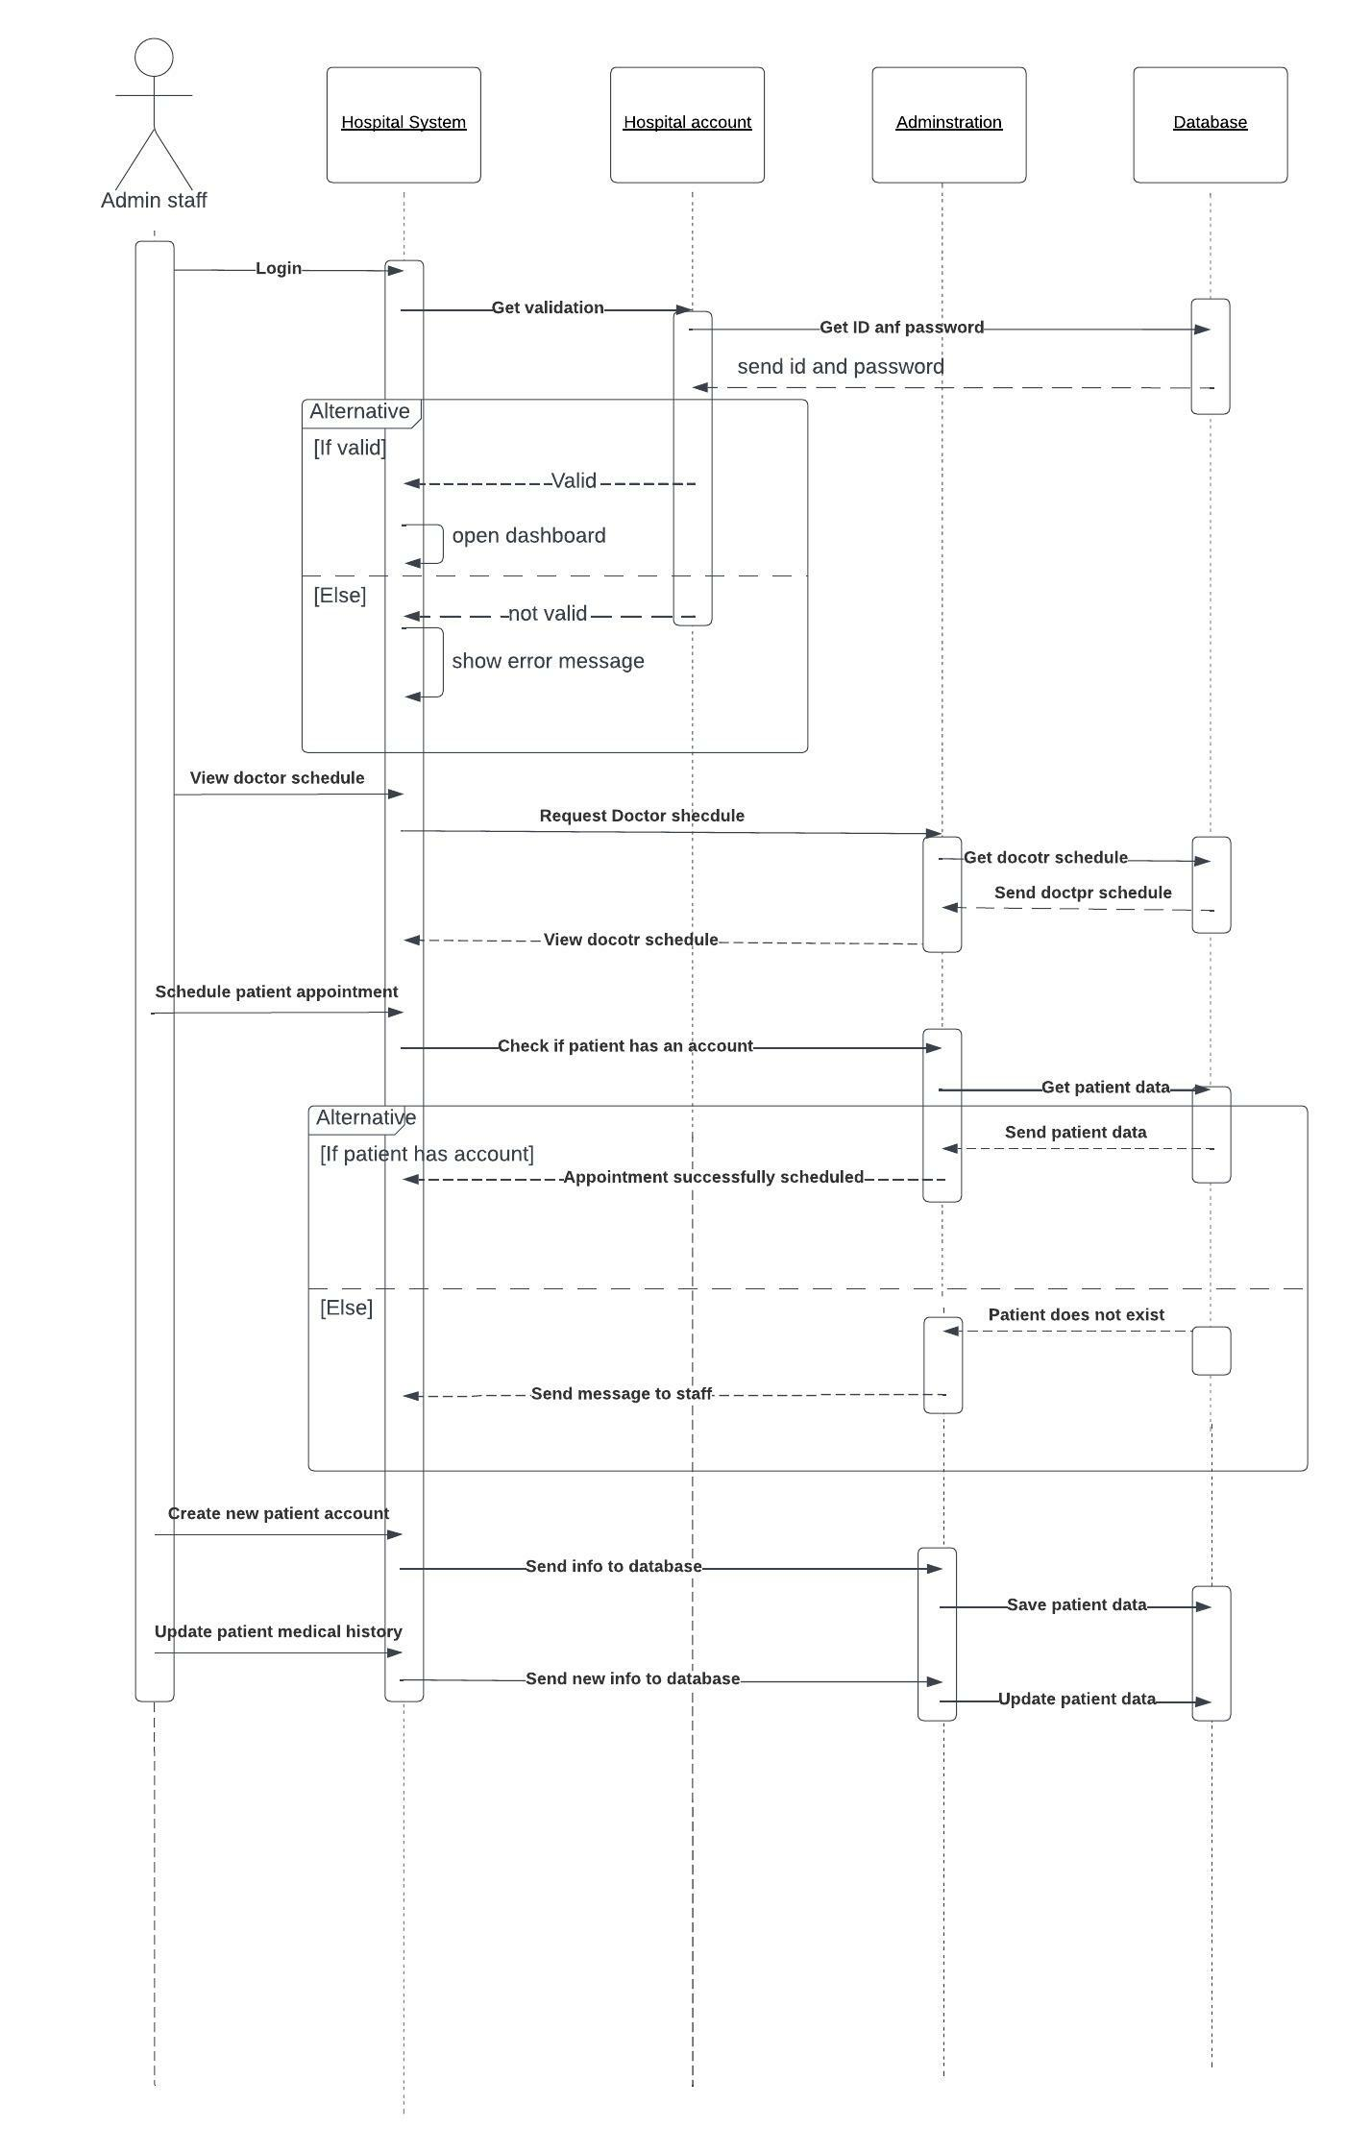
Admin Sequence Diagram

Slide 9
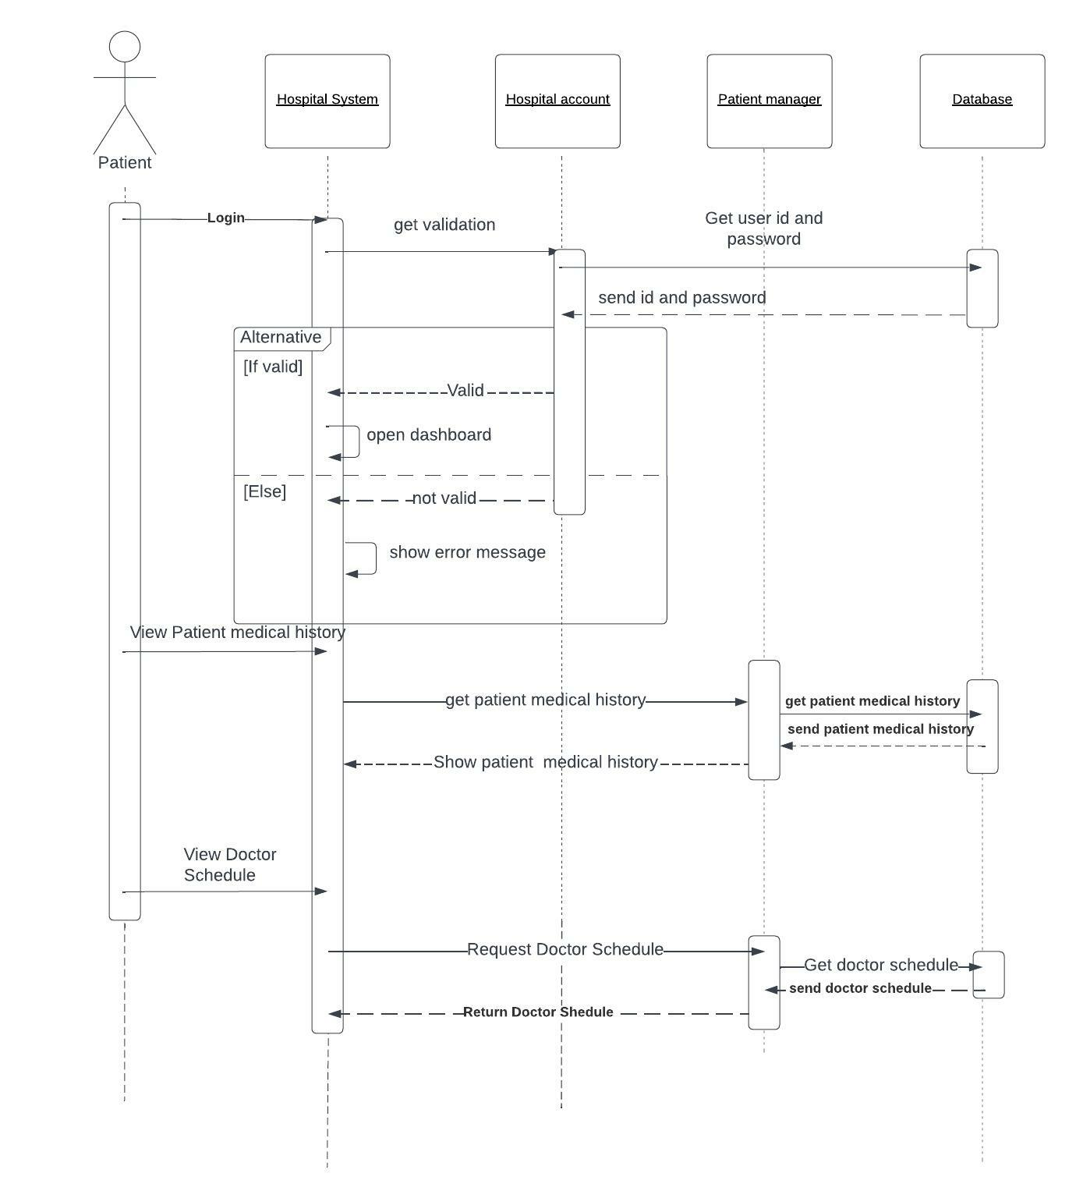
Patient Sequence Diagram

Slide 10
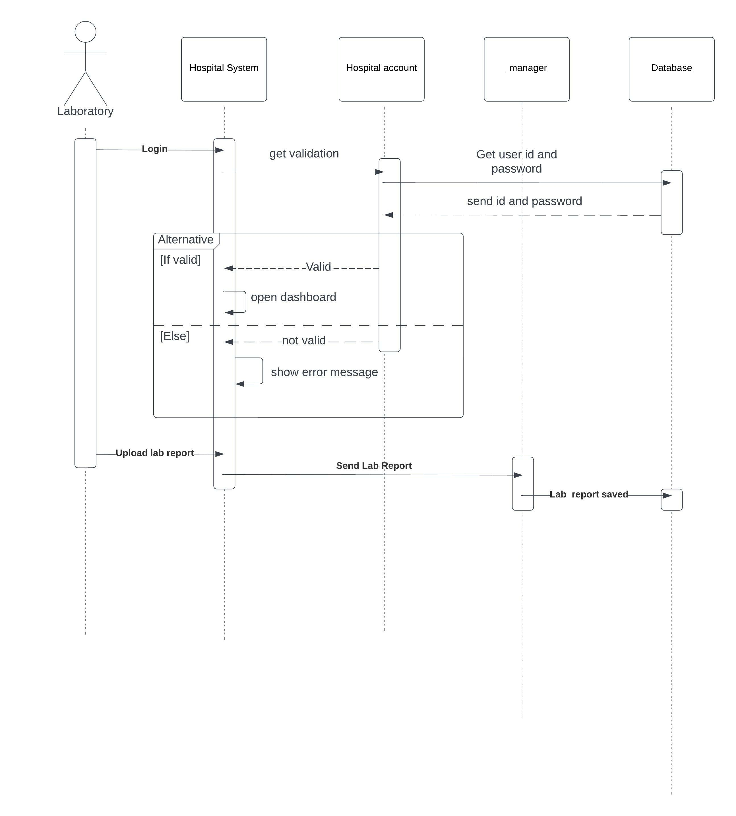
Laboratory Sequence Diagram

Slide 11
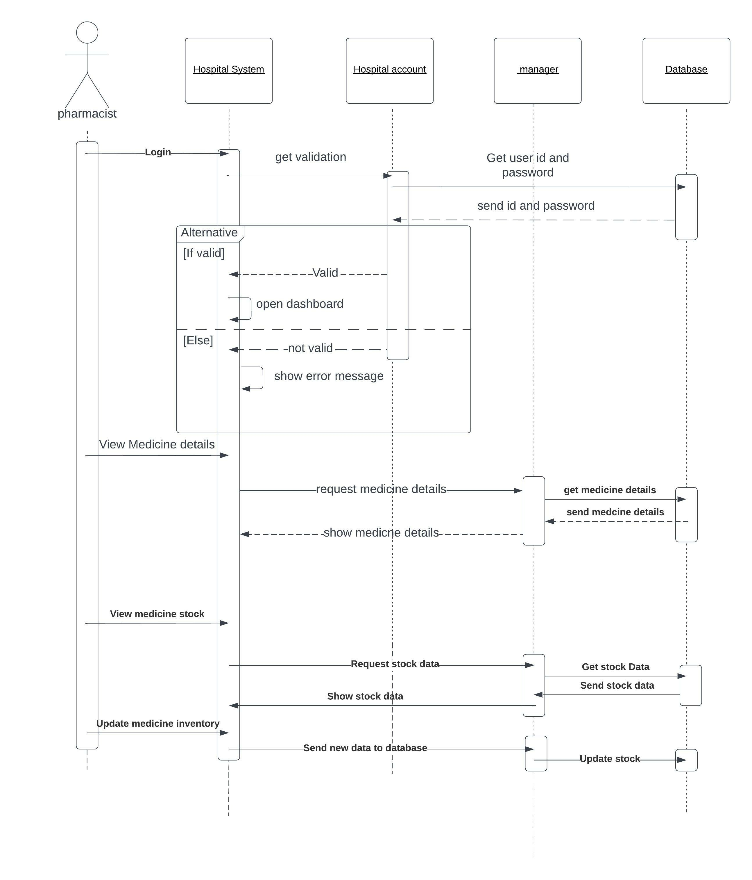
Pharmacy Sequence Diagram

Slide 12
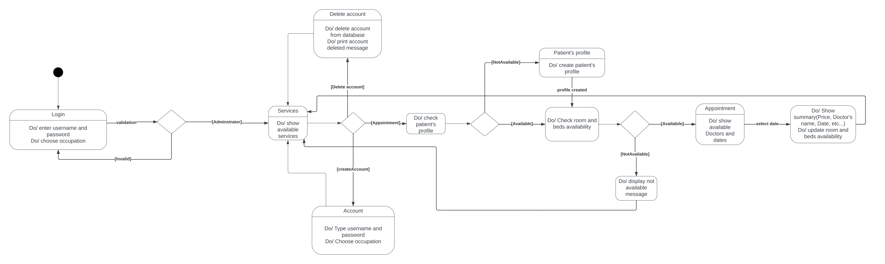
Admin State Diagram

Slide 13
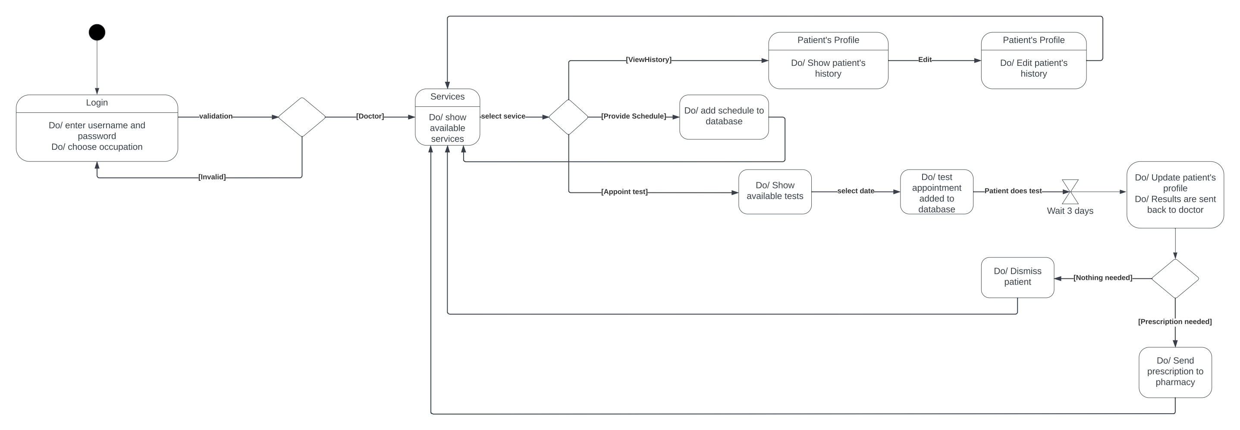
Doctor State Diagram

Slide 14
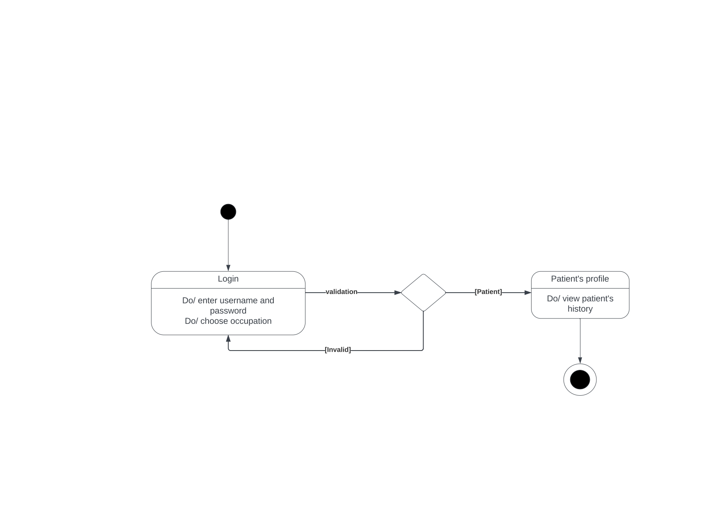
Patient State Diagram

Slide 15
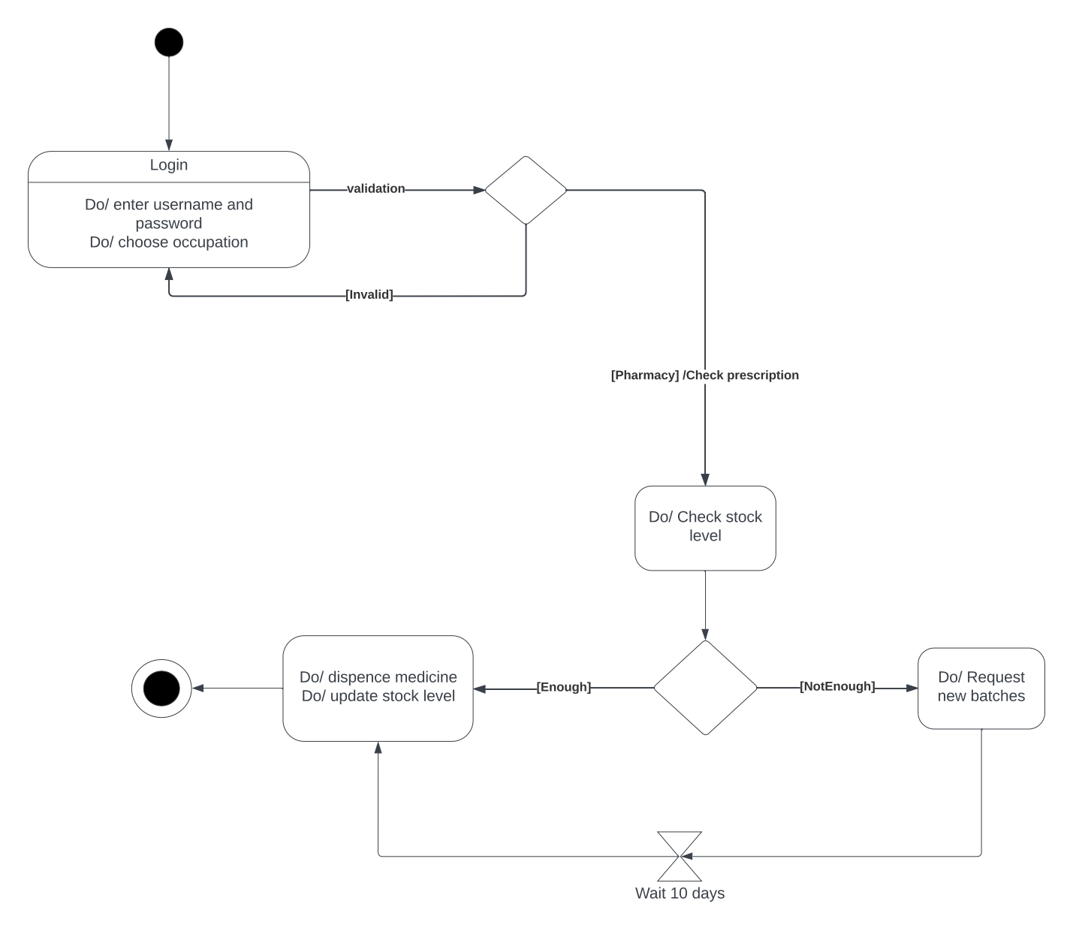
Pharmacy State Diagram

Slide 16
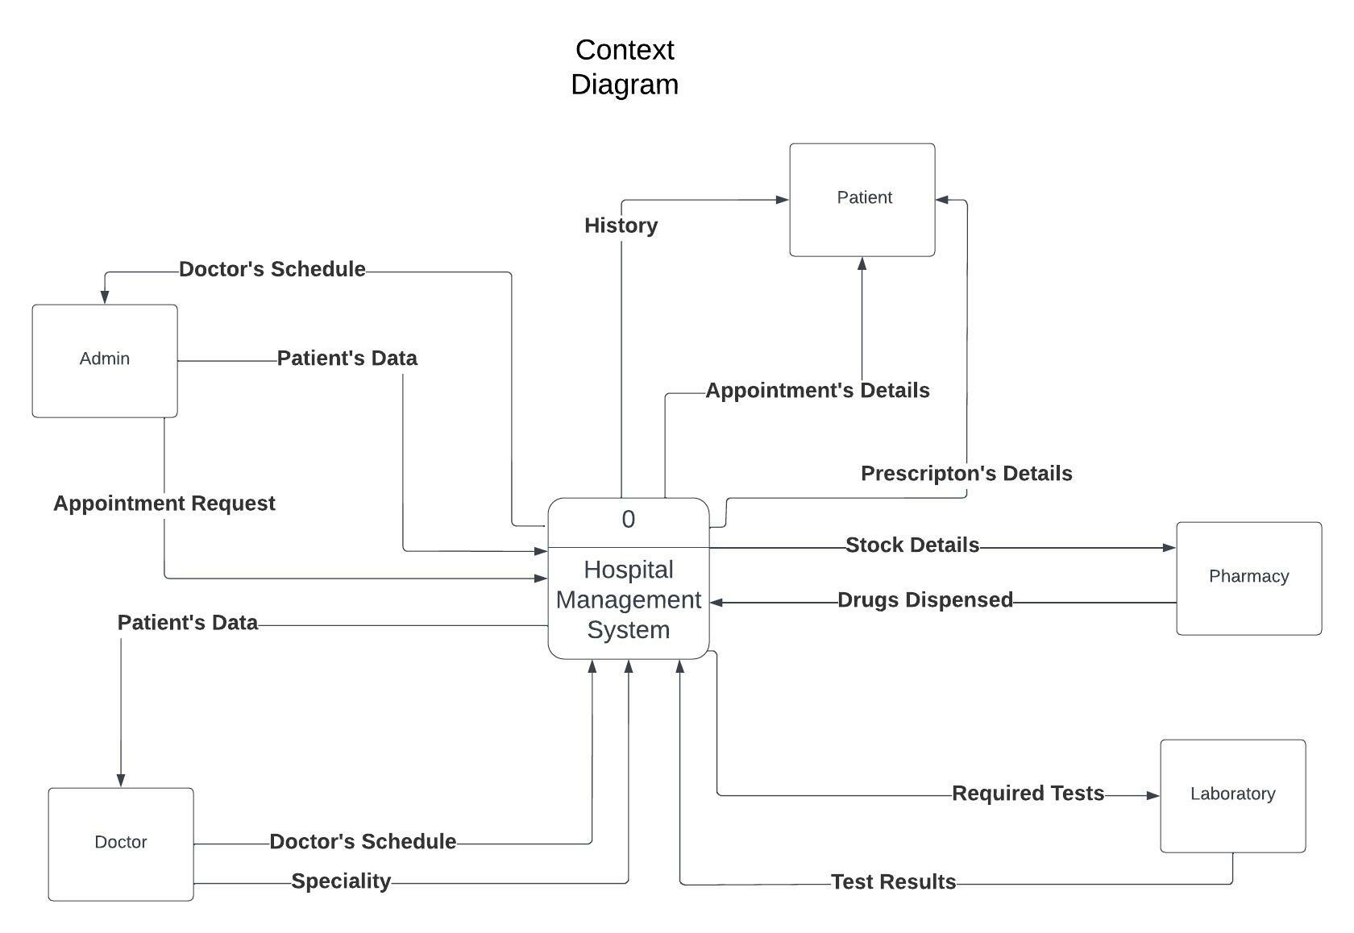
Dfd Daigarm

Slide 17
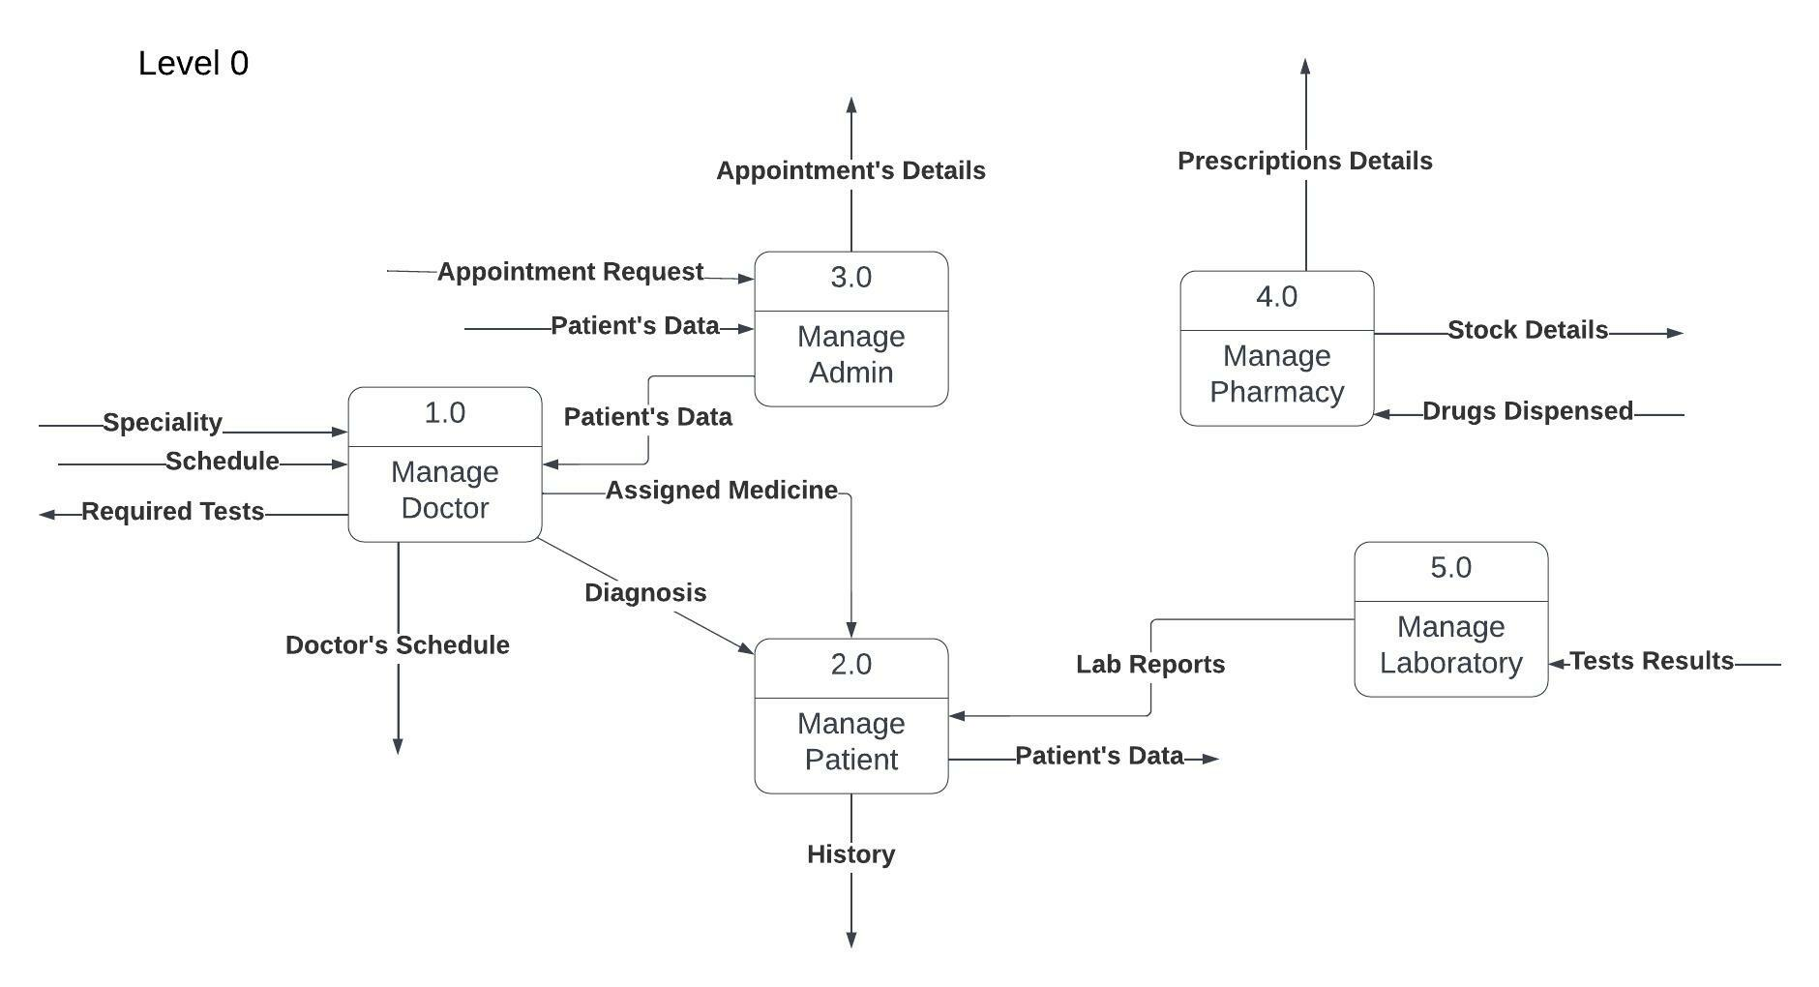
Dfd Daigarm

Slide 18
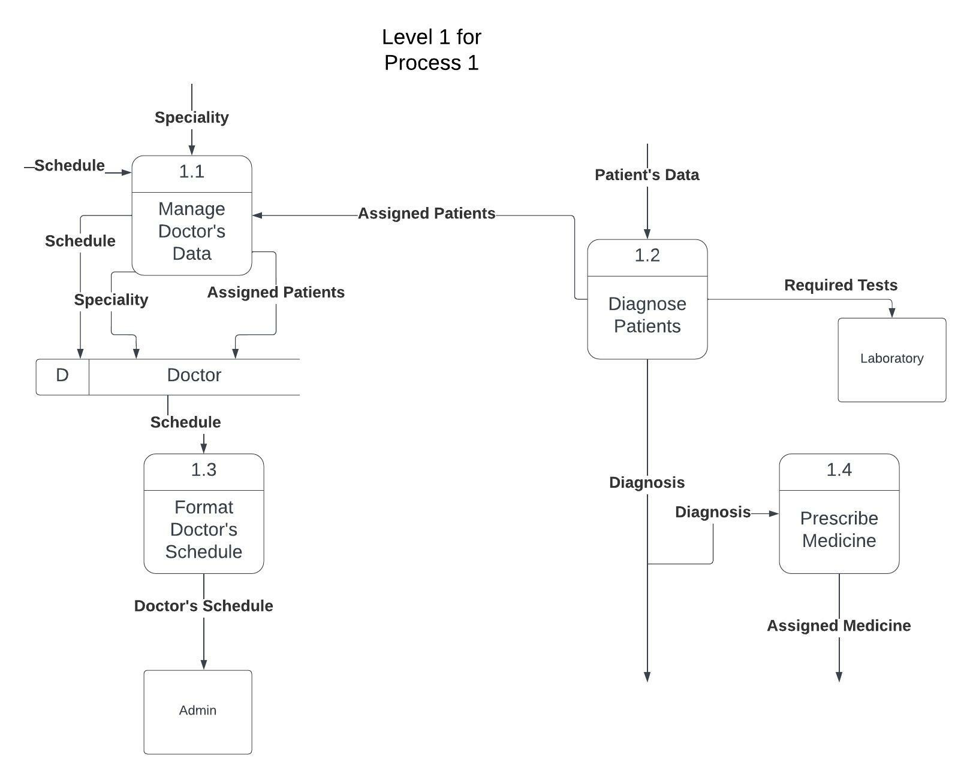
Dfd Daigarm

Slide 19
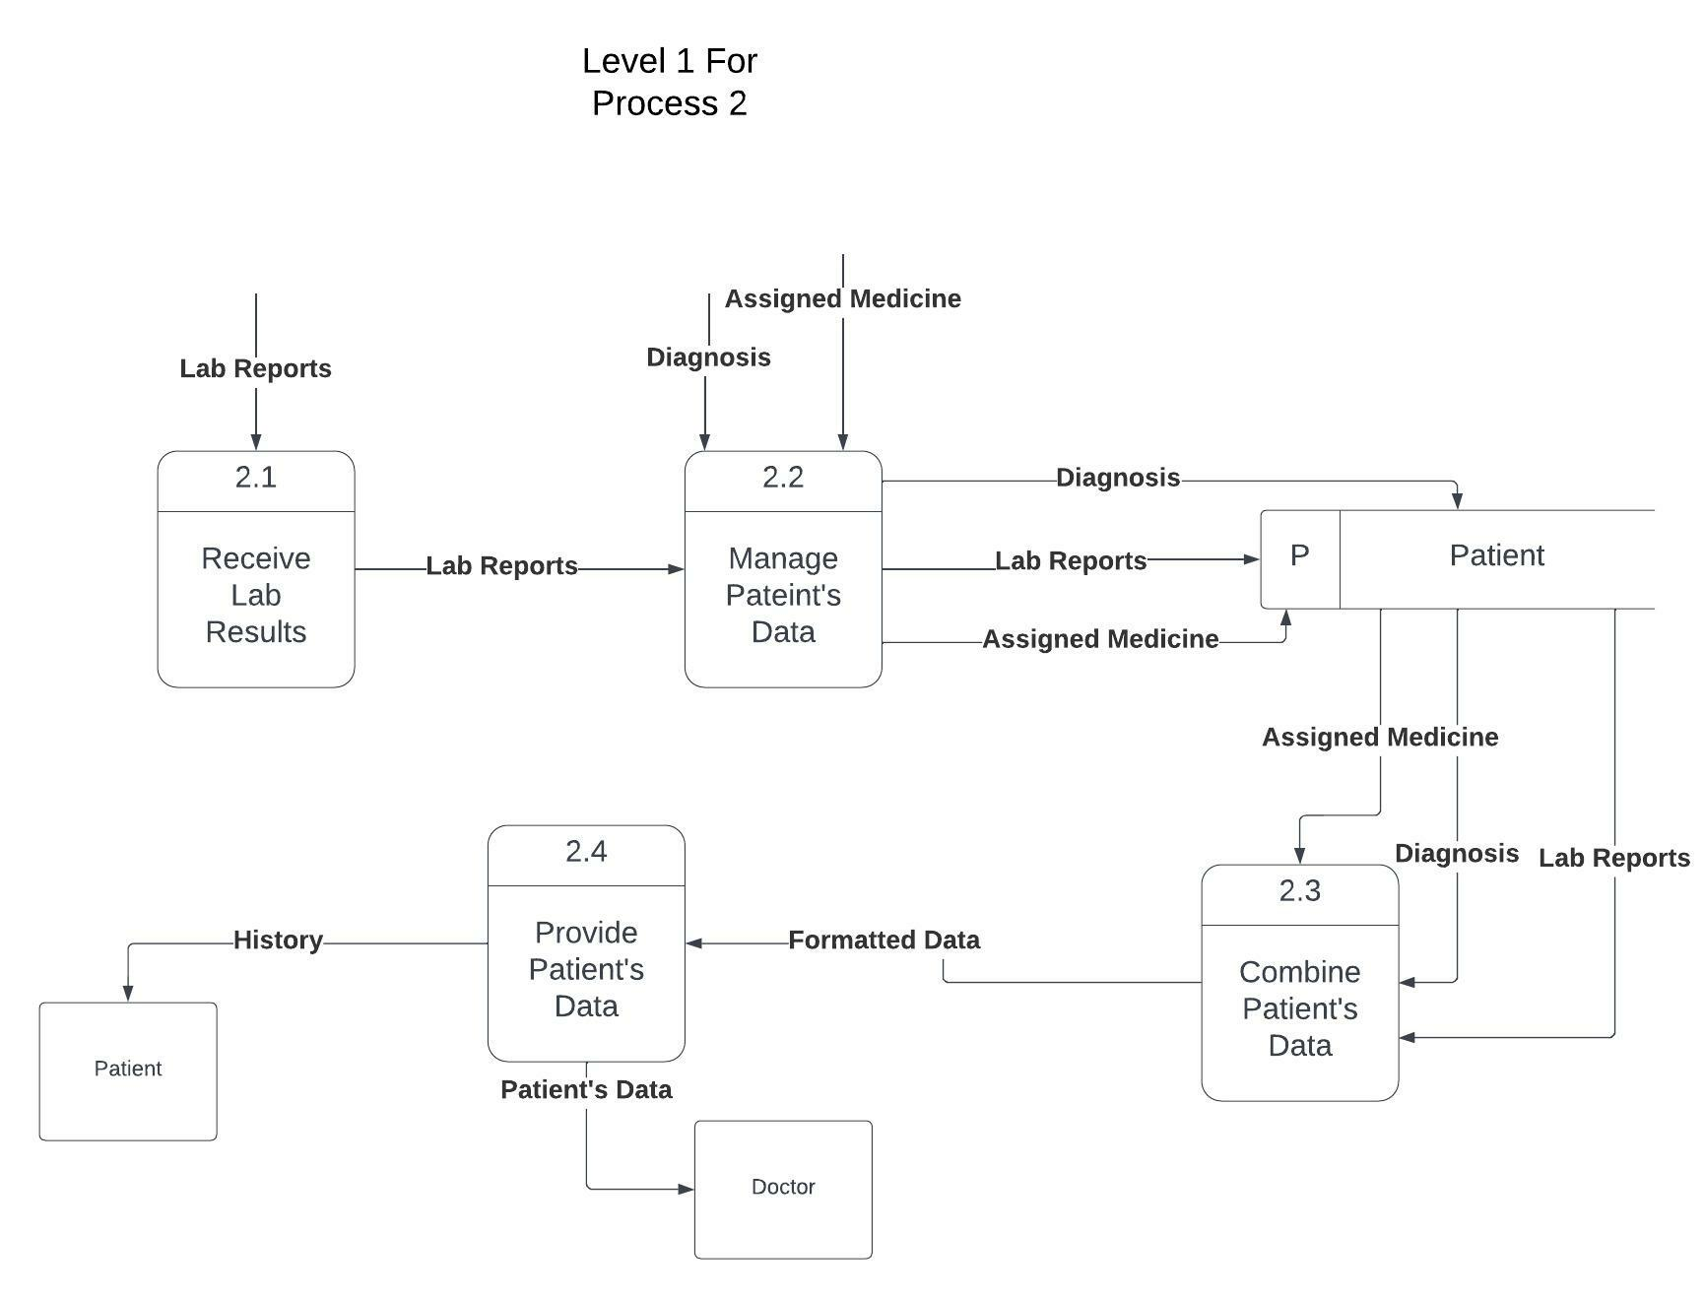
Dfd Daigarm

Slide 20
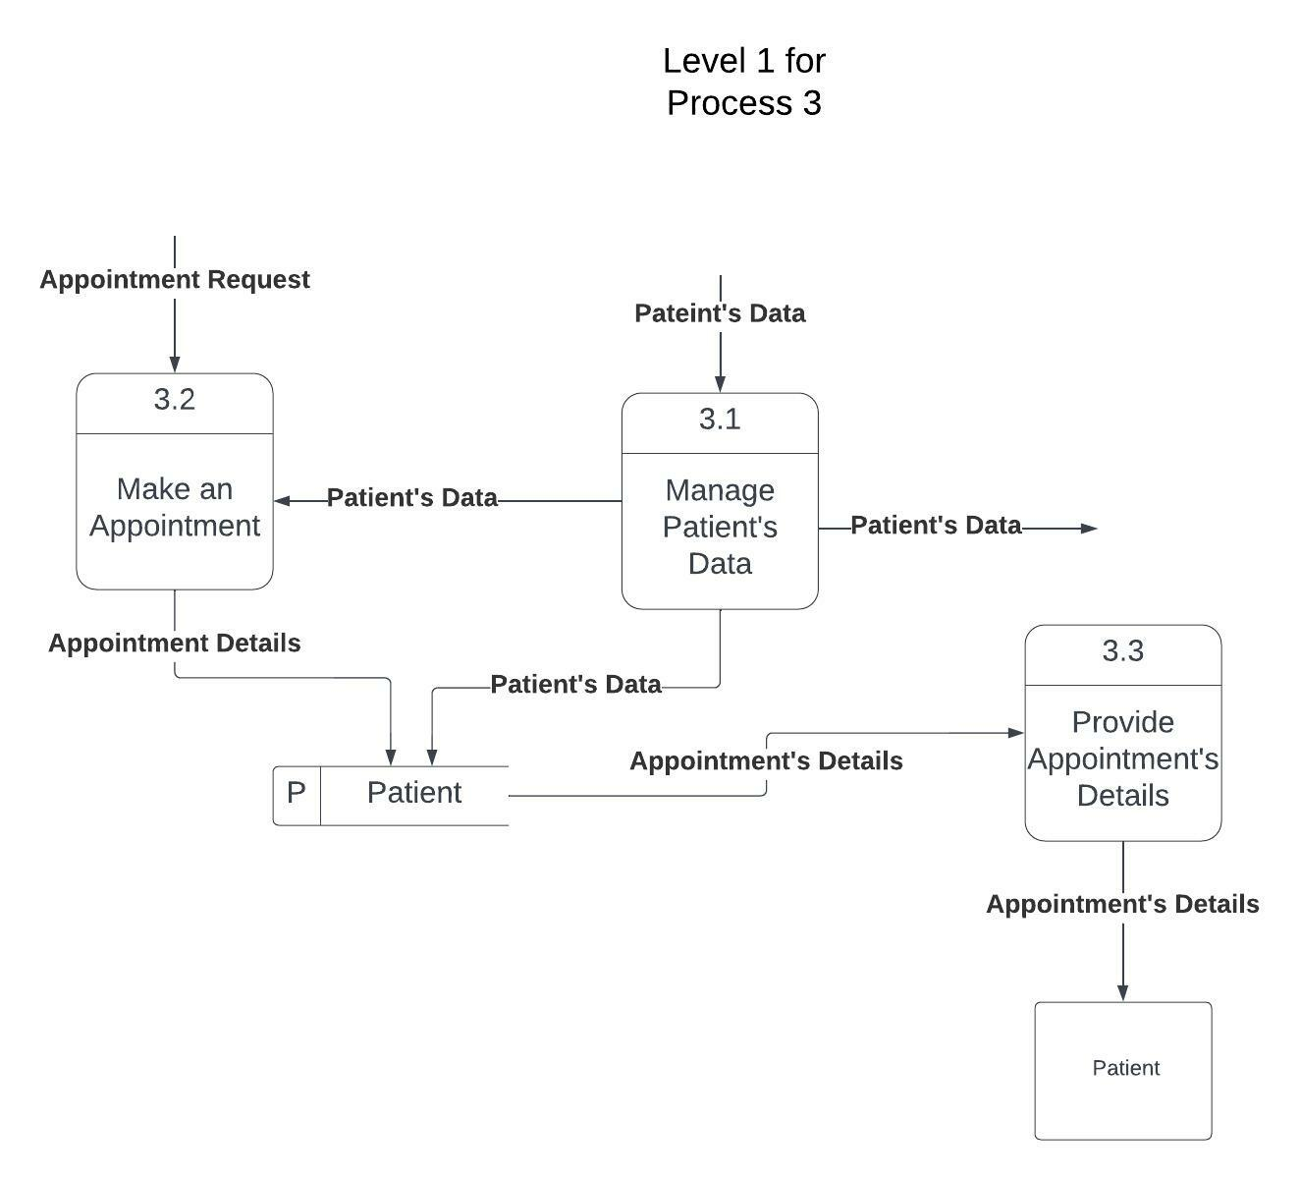
Dfd Daigarm

Slide 21
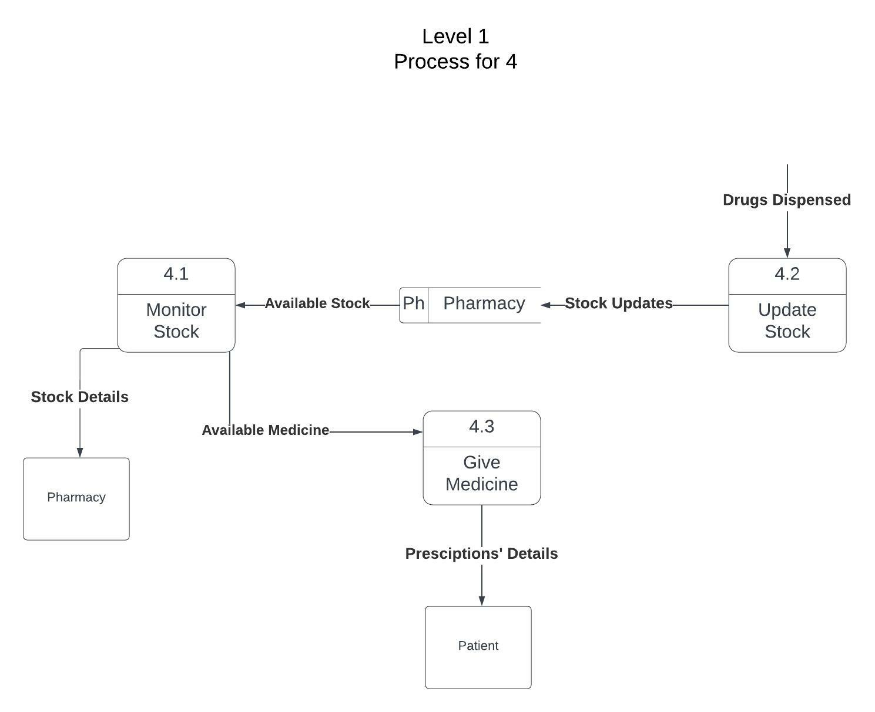
Dfd Daigarm

Slide 22
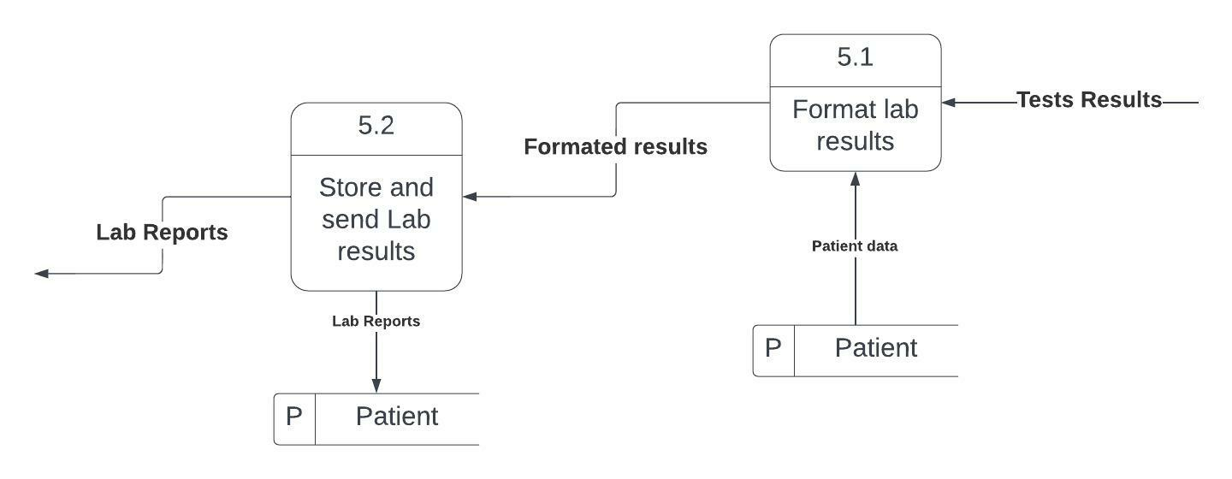
Dfd Daigarm

Slide 23
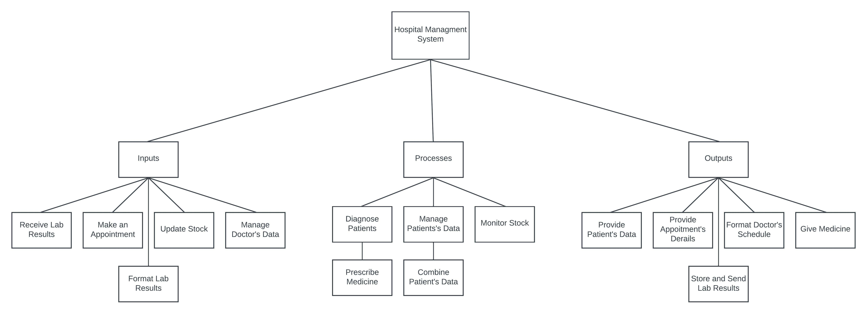
Dfd Architecture

Slide 24
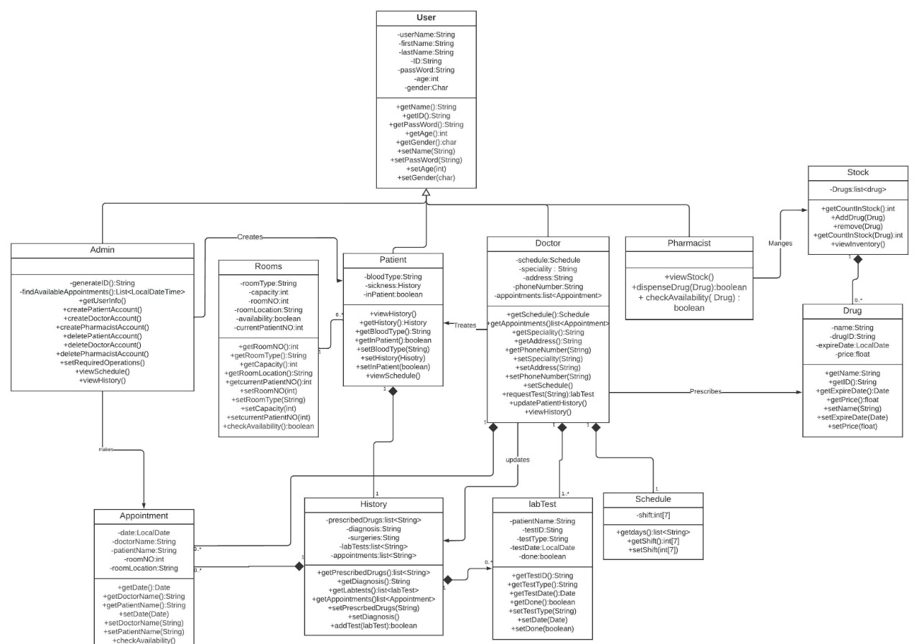
Class Diagram

Slide 25
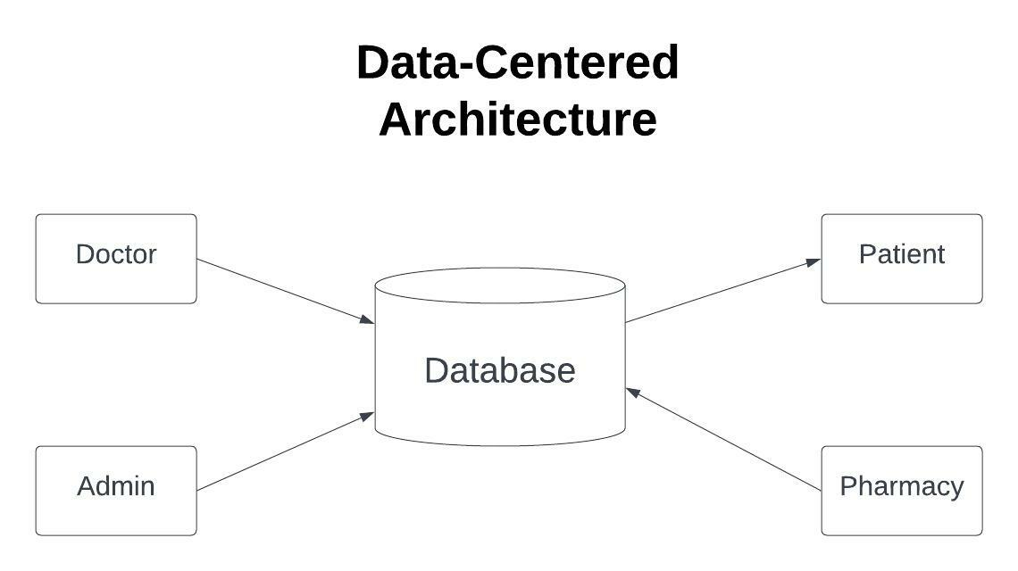
Architecture Style

Slide 26
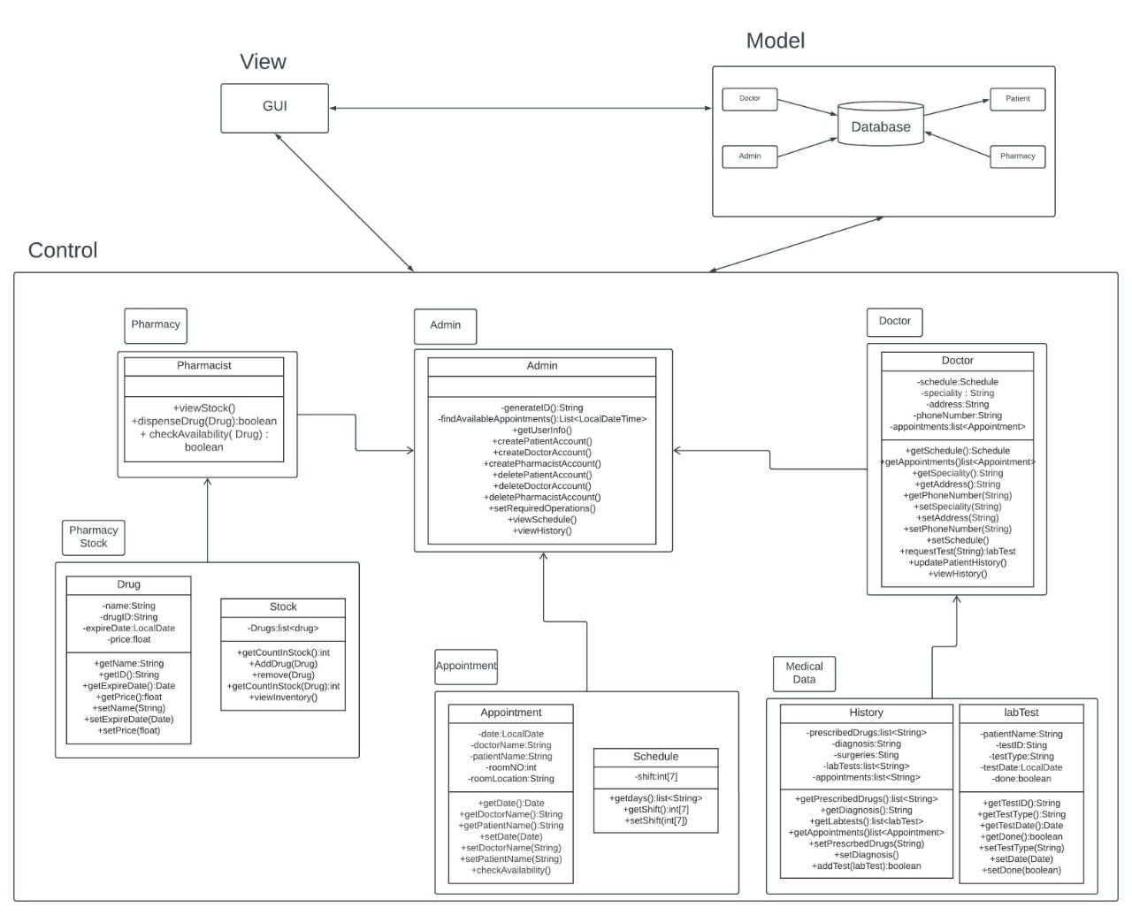
Architecture Style

